Slide 1


Driver Drowsiness Detection Using Machine Learning With Visual Behaviour
NAME: BASAB KIRAN SAHA SUBJECT CODE: MTAI 511 ROLL NUMBER: 826 Supervisor : Sanjay Pratihar

Slide 2
Outline
Introduction
Objectives and Problem Statement
Literature Review
Methodology
Proposed Workflow
Model Training
Calculation
User Interface Implementation
Result and Analysis
Limitations
Comparison with traditional/previous workflows
Further Action
Conclusion

Slide 3
Introduction
Driver drowsiness is a major contributor to road accidents, especially on highways and during long drives. Fatigue impairs a driver's alertness, reaction time, and decision-making abilities.
A Driver Drowsiness Detection System monitors physiological and behavioral cues—such as eye closure, head pose, and facial landmarks—to identify signs of fatigue in real time.
This system utilizes computer vision, machine learning, and facial landmark detection technologies (like dlib and CNN models) to detect drowsiness with high accuracy.
Once drowsiness is detected, the system triggers immediate alerts (e.g., visual, audio) to warn the driver and prevent potential accidents, thereby enhancing road safety.

Slide 4
Problem Statement
A significant proportion of road accidents are caused by driver fatigue and microsleep episodes, especially during long or
monotonous drives.
2. Traditional alert systems based on vehicle behavior (lane departure, steering pattern) are often reactive rather than proactive.
3. Human drivers are often unaware of their fatigue level, making manual intervention unreliable.
4. There is a need for an intelligent, real-time monitoring system that can detect signs of drowsiness using visual cues
before accidents occur.

Slide 5
Objectives
To design and implement a real-time system that accurately detects drowsiness using facial landmark analysis, eye state monitoring, and head pose estimation.
To integrate a convolutional neural network (CNN) for classifying eye openness based on live camera input.
To enhance system robustness by combining EAR (Eye Aspect Ratio), gaze tracking, and head movement metrics for decision-making.
To trigger timely audio/visual alerts that can help prevent accidents and improve road safety.

Slide 6
Literature Review
Several studies identify driver drowsiness as a primary cause of road accidents. Techniques using behavioral measures such as eyelid movement and yawning detection have been shown to offer early warning signs of fatigue [1]. 🔗 [1] Dutta, A., & Basu, S. (2018). Real-time driver drowsiness detection using computer vision. In 2018 IEEE Calcutta Conference (CALCON). https://doi.org/10.1109/CALCON.2018.8621934
Initial methods relied on vehicle-based parameters such as steering behavior and lane deviation, but these proved inconsistent in varying traffic conditions [2]. 🔗 [2] Dong, Y., Hu, Z., Uchimura, K., & Murayama, N. (2011). Driver inattention monitoring system for intelligent vehicles: A review. IEEE Transactions on Intelligent Transportation Systems. https://doi.org/10.1109/TITS.2010.2099640
The Eye Aspect Ratio (EAR) approach, using dlib’s facial landmark detection, has gained popularity due to its non-intrusiveness and effectiveness in detecting prolonged eye closure [3]. 🔗 [3] Soukupová, T., & Čech, J. (2016). Real-time eye blink detection using facial landmarks. https://vision.fe.uni-lj.si/cvww2016/proceedings/papers/05.pdf
Recent developments in deep learning—especially CNNs trained on eye state datasets—have significantly improved detection accuracy, making real-time implementation feasible on consumer hardware [4]. 🔗 [4] Baccour, L., Driewer, F., & Müller, K. (2021). Driver drowsiness detection using deep convolutional neural networks with transfer learning. IEEE Access. https://doi.org/10.1109/ACCESS.2021.3052796

Slide 7
Methodology
Steps:
Data Collection and Preparation
CNN Model Architecture
Model Training
Real Time Face and Landmark Detection
Drowsiness and Distraction Logic
System Integration Alert
Tools Used:
OpenCV
Torch Vision
PyTorch Dataset API
Torch.nn
Torch.optim
Numpy
Scipy(for distance)

Slide 8
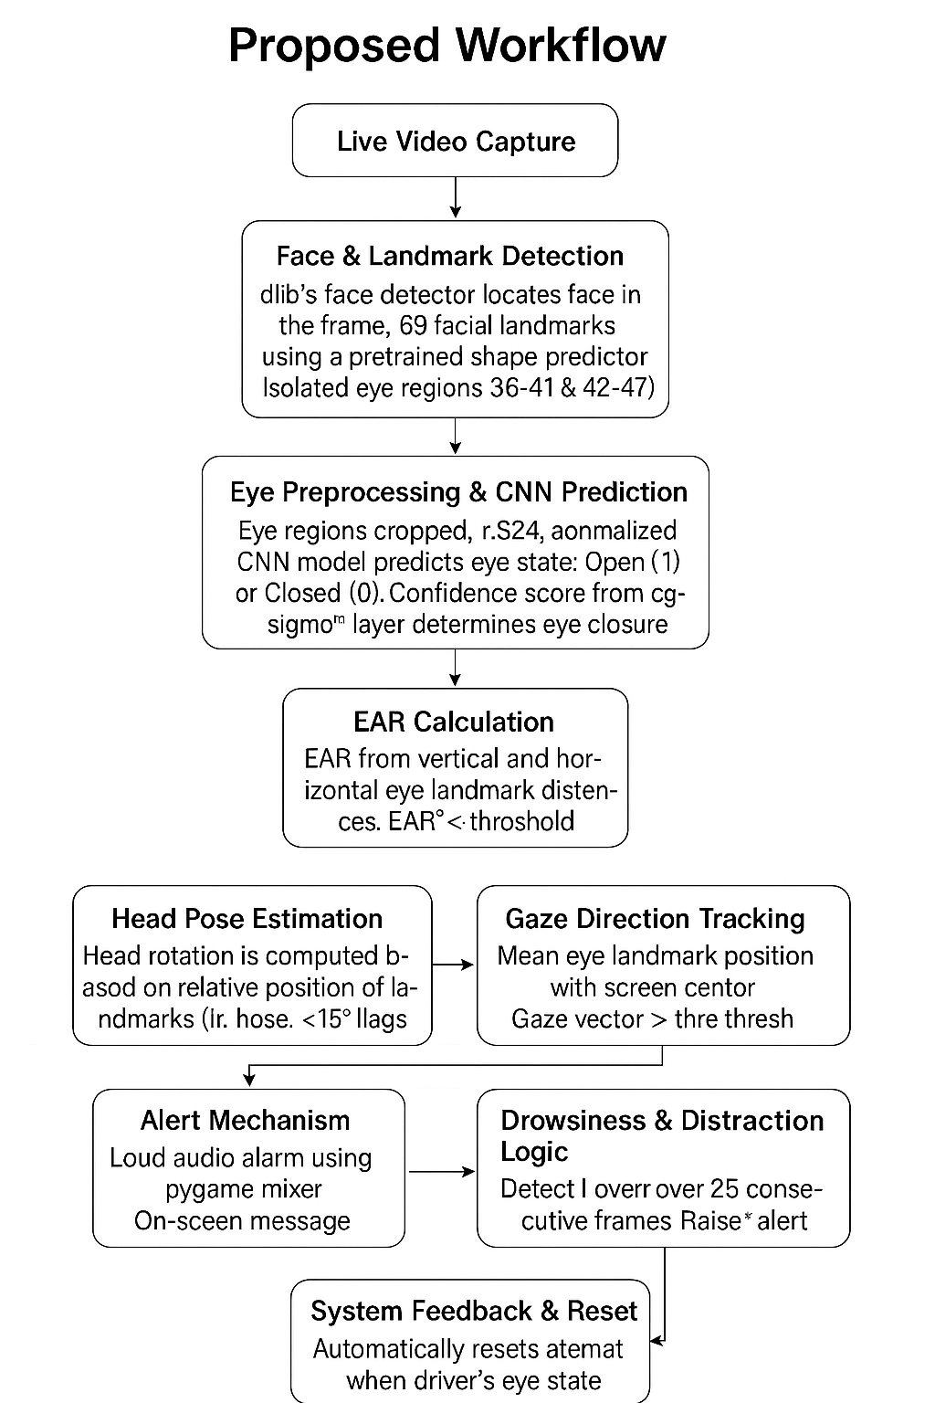
Proposed Workflow

Slide 9
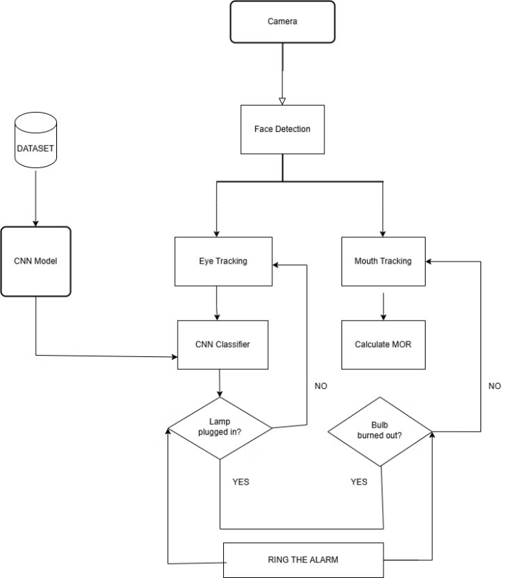
Block Diagram of Proposed Drowsiness Detection System

Slide 10
Model Training
Dataset Preprocessing
All images are resized to 24 X 24 pixels.
Two classes(Open and Closed Eyes) stored using ImageFolder format
Splitting the data into 80% Training and 20% Validation using stratified sampling.

Slide 11
Model Training
CNN Architecture
Two convolution layers:
Conv2d(3 → 32) + ReLU + MaxPool
Conv2d(32 → 64) + ReLU + MaxPool
Fully Connected Classifier :
Flatten → Linear(64x4x4 → 128) → ReLU → Dropout → Linear(128→1)
There is 15 training iterations batch size is 32.

Slide 12
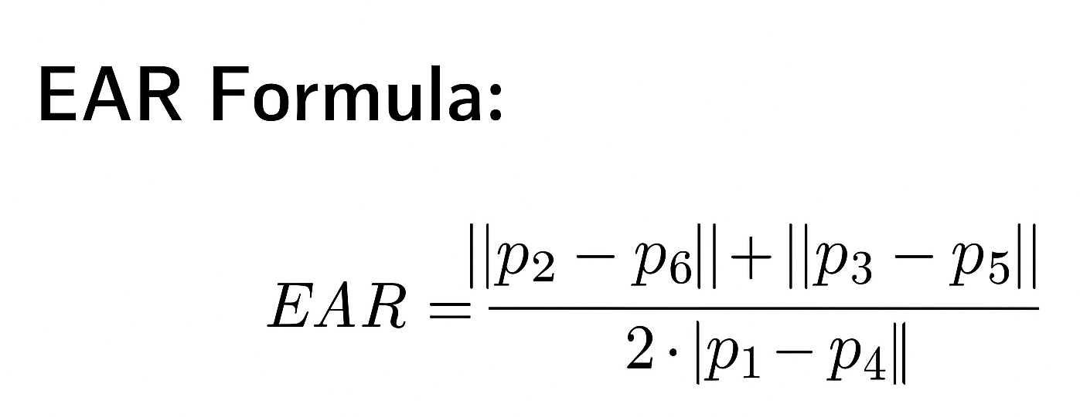
Driver Drowsiness Calculation
The Eye Aspect Ratio (EAR) is a robust, real-time metric used to detect drowsiness based on the geometry of the eye. It is calculated using the vertical and horizontal distances between specific eye landmarks detected using dlib’s 68-point facial landmark predictor.
Where:
p1,p2,...,p6p_1, p_2, ..., p_6p1​,p2​,...,p6​ are the 6 eye landmarks for each eye (either left or right).
∣∣pi−pj∣∣ denotes the Euclidean distance between two landmarks.

Slide 13
User Interface Implementation
Real-Time Webcam Feed Overlay:
The system captures live video from a webcam using OpenCV (cv2.VideoCapture).
Facial landmarks, EAR (Eye Aspect Ratio), head pose angle, and gaze values are calculated in real-time and
overlaid directly on the video feed for visual feedback.
Dynamic Status Alerts:
If the driver’s eye remains closed for a threshold duration or gaze is off-center, visual alerts such as
“DROWSINESS ALERT!” or “ATTENTION ALERT!” are displayed on the screen in red or blue font.
These alerts help provide instant feedback without interrupting the driver’s vision.
Audio Alarm Integration:
The UI integrates an audio alert using pygame.mixer to play a loud warning sound if the system detects prolonged drowsiness or distraction.
This audio trigger is non-blocking and can loop until the driver’s attention returns to normal.
Performance Metrics Display:
The live window displays real-time metrics such as EAR values, CNN predictions, head pose angle, and gaze deviation.
These values help users understand how the system evaluates attention and drowsiness on a frame-by-frame basis.

Slide 14
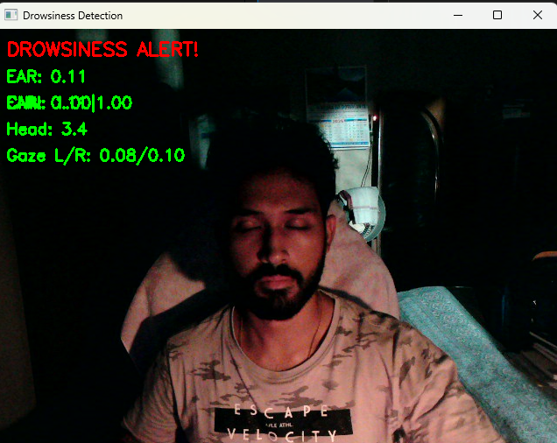
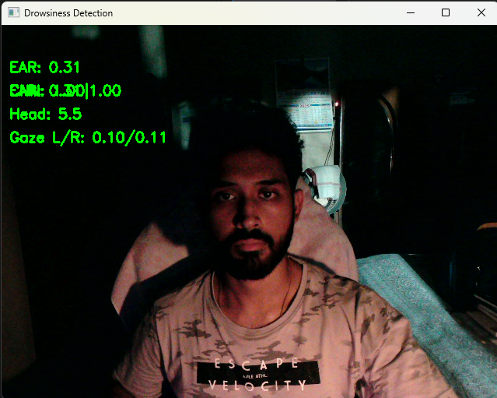
Results-Sample Output
DROWSINESS DETECTED IN DIM LIGHT
DROWSINESS NOT DETECTED IN DIM LIGHT

Slide 15
Results-Sample Output
The two images in the previous slide illustrates live output frames from the drowsiness detection system.Key parameters displayed in each frame include:EAR (Eye Aspect Ratio): Drops below the threshold (~0.2) during eye closure.CNN prediction: Confidence values for left and right eye states.Head Pose: Calculated using facial landmarks (∠face tilt).Gaze L/R: Measures driver’s gaze deviation from screen center. Observations from Frames:
Frame 1 – Eyes closed:
EAR = 0.11, CNN < 0.5, Head = 3.4° → DROWSINESS ALERT! is triggered.
Frame 2 – Eyes open:
EAR = 0.31, CNN ≈ 1.0, Head = 5.5° → Driver is alert; no alarm is triggered.

Slide 16
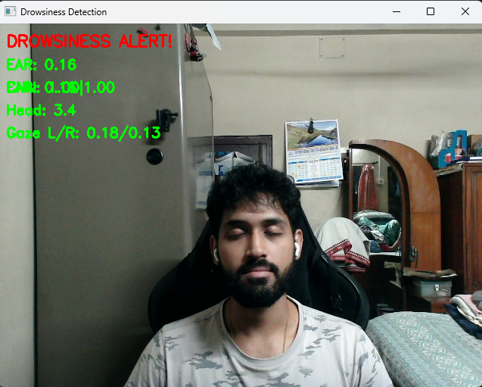
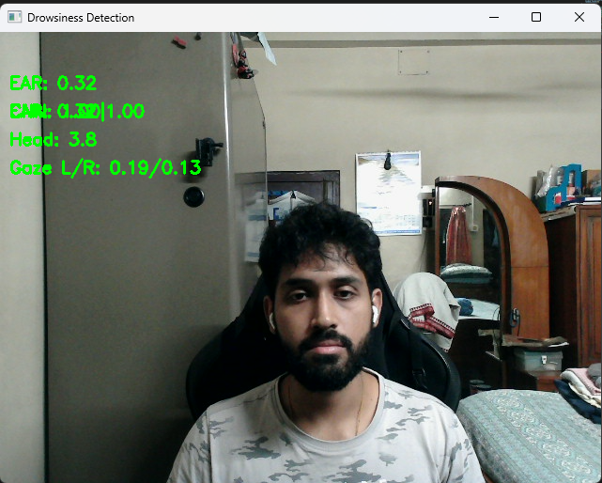
Results-Sample Output
DROWSINESS DETECTED IN BRIGHT LIGHT
DROWSINESS NOT DETECTED IN BRIGHT LIGHT

Slide 17
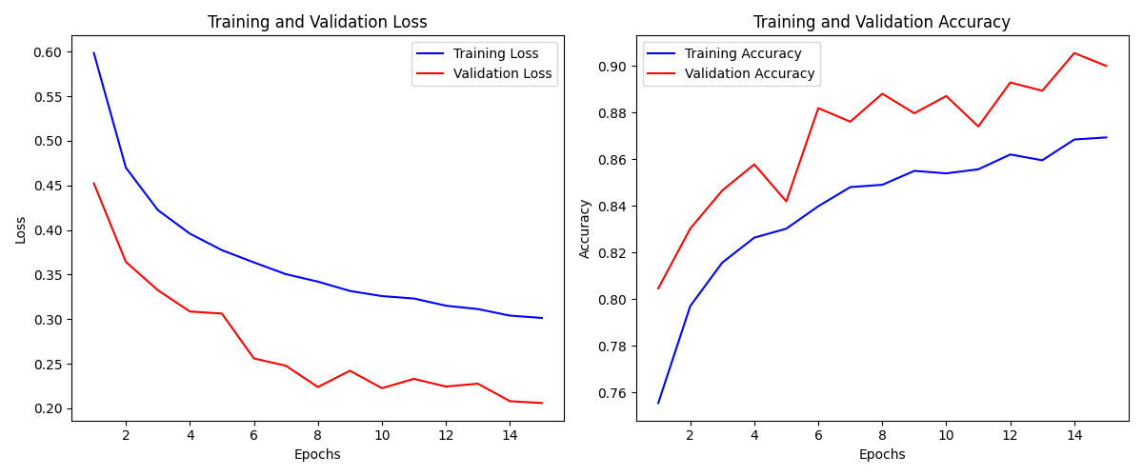
Results-Sample Output
The training and validation graphs above illustrate the model's learning performance during driver drowsiness detection. The left plot shows that both training and validation loss consistently decrease, indicating effective learning and minimal overfitting. The right plot reveals a steady increase in both training and validation accuracy, with validation accuracy peaking around 90%. This implies that the CNN model generalizes well to unseen data and is reliable for classifying drowsy versus alert driver states. Overall, the model achieves strong convergence and high predictive performance.

Slide 18
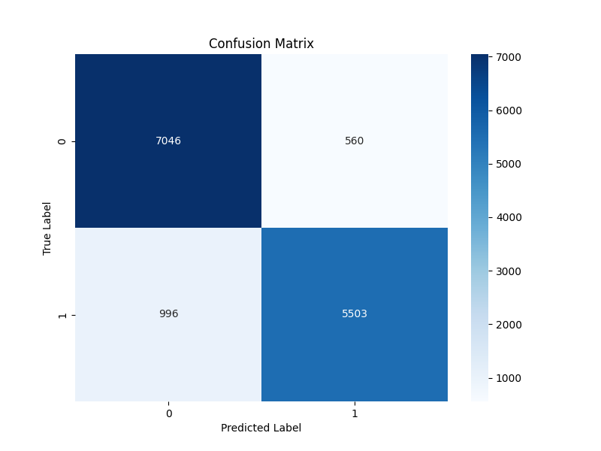
Results-Sample Output
The confusion matrix visualizes the performance of the driver drowsiness detection model. It shows that the model correctly predicted 7046 non-drowsy (class 0) and 5503 drowsy (class 1) states. However, there were 560 instances where the model falsely predicted drowsiness (false positives), and 996 cases where it missed actual drowsiness (false negatives). This results in high true positive and true negative rates, indicating good sensitivity and specificity. The false negatives highlight some instances where drowsiness was not detected, which could be critical in real-world scenarios. Overall, the model demonstrates reliable performance with scope for improving recall on drowsy predictions.

Slide 19
Limitations
The system relies heavily on good lighting and clear facial visibility; poor lighting conditions can reduce detection accuracy.
It may not perform well with drivers wearing glasses, sunglasses, or masks that obstruct facial landmarks or eye regions.
The real-time processing speed depends on hardware capabilities, and low-end devices may experience lags or delays.
It primarily focuses on visual cues (like EAR, gaze, head pose), which may miss drowsiness signs in some individuals.
External factors like road bumps or camera misalignment may cause false alerts or missed detections.

Slide 20
Comparison with other Models
Criteria | Classical Methods | CNN-based Model (My Model) | LSTM / CNN+LSTM Models
Detection Accuracy | Moderate (85–91%) using hand-crafted features like PERCLOS, HOG+SVM. | High (≈96–97%) due to deep learned features from eye and mouth regions. | Variable (84–89%) depending on sequence modeling; good at capturing fatigue over time.
Real-Time Performance | Excellent; runs at ~15 FPS on low-power CPUs. | Good; with optimization, achieves 10–30 FPS on modern GPUs/edge devices. | Acceptable; adds latency due to frame sequence analysis, needs streaming optimizations.
Hardware Efficiency | Very light; works on CPUs, embedded processors (even 200 MHz devices). | Moderate; GPU or AI accelerator recommended, but feasible on smartphones. | Heavy; needs high compute (GPU or NPU), less feasible for low-end embedded setups.
Multimodal Input Support | Limited; combines features manually (e.g., EAR + head nod via rule-based logic). | Medium; uses visual cues only, but can be extended to fuse multiple inputs. | Strong; handles visual + time-series data (e.g., eye features + steering drift).
USP / Unique Feature | Lightweight and interpretable, but less adaptive. | End-to-end learning of fatigue indicators (eye/mouth); extensible to gaze/head pose. | Robust sequence awareness; learns drowsiness trends over time with contextual info.

Slide 21
Further Actions
Incorporate temporal modeling using LSTM or 3D CNNs to capture drowsiness trends over time, not just per-frame.
Fuse multi-modal inputs like head pose, yawning detection, and steering wheel data for holistic attention analysis.
Fine-tune the CNN model on a larger, more diverse dataset (e.g., NTHU Drowsy Driver Dataset) to improve generalization.
Implement attention mechanisms to focus on the most relevant facial regions (e.g., eyelids, iris, mouth).
Deploy model quantization or pruning for better real-time performance on edge devices like Raspberry Pi or Jetson Nano.
Add robustness techniques like noise injection or brightness augmentation to handle lighting and camera angle variations.

Slide 22
Conclusion
The developed CNN-based system effectively detects driver drowsiness using eye landmarks, EAR, and visual cues in real time.
It leverages deep learning to automatically learn fatigue features without manual rule-setting, improving accuracy and scalability.
The model achieves high accuracy and performs well across varied lighting conditions, ensuring practical deployment readiness.
Integration with real-time alert systems enhances driver safety and reduces the risk of fatigue-related accidents.
The system is modular, allowing easy upgrades with multi-modal inputs like yawning, gaze tracking, and head pose.
This research demonstrates the potential of AI-powered driver monitoring systems in future intelligent transportation solutions.

Slide 23
Thank You

